Slide 1


Modeling Number of Cars with a Cumulative Logit Model
Jenny Eberling

Slide 2
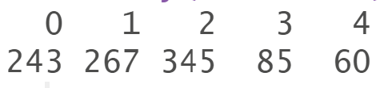
The Data
Kaggle – bike shop
1000 complete data points
13 Variables
1 ID
1 to be predicted (number of cars)
That leaves 11
Number of Cars

Slide 3
Variables
Commute Distance (Nominal)
Education
Occupation
Income (USD)
Children
Region
Purchased Bike
Homeowner
Marital Status
Gender
Age
Cars!

Slide 4
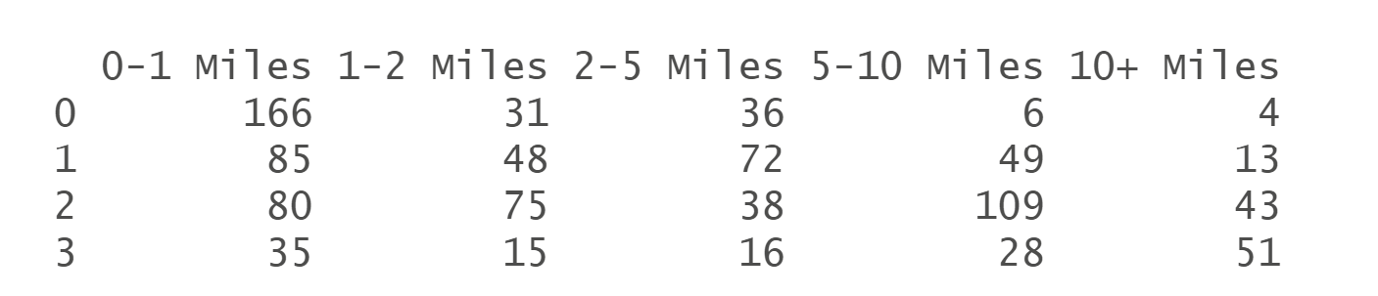
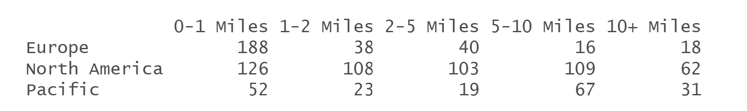
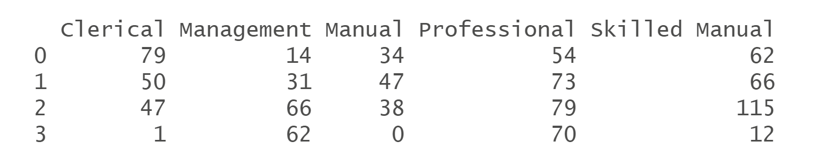
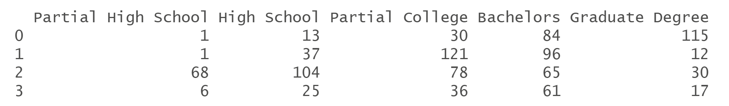

Slide 5
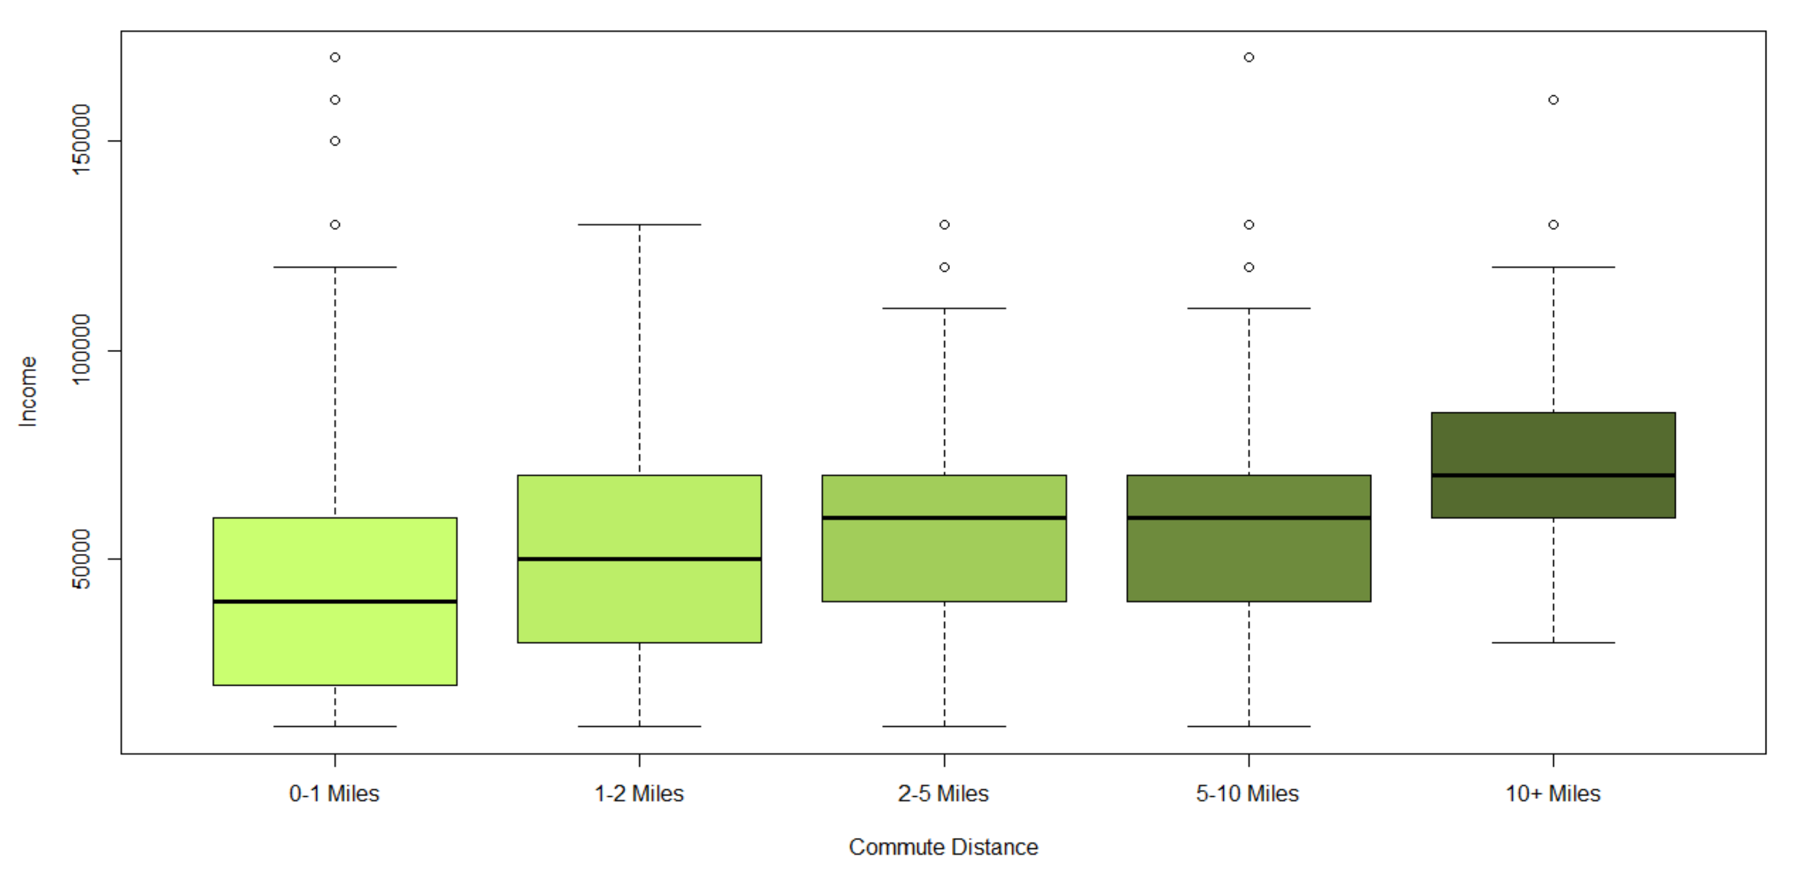
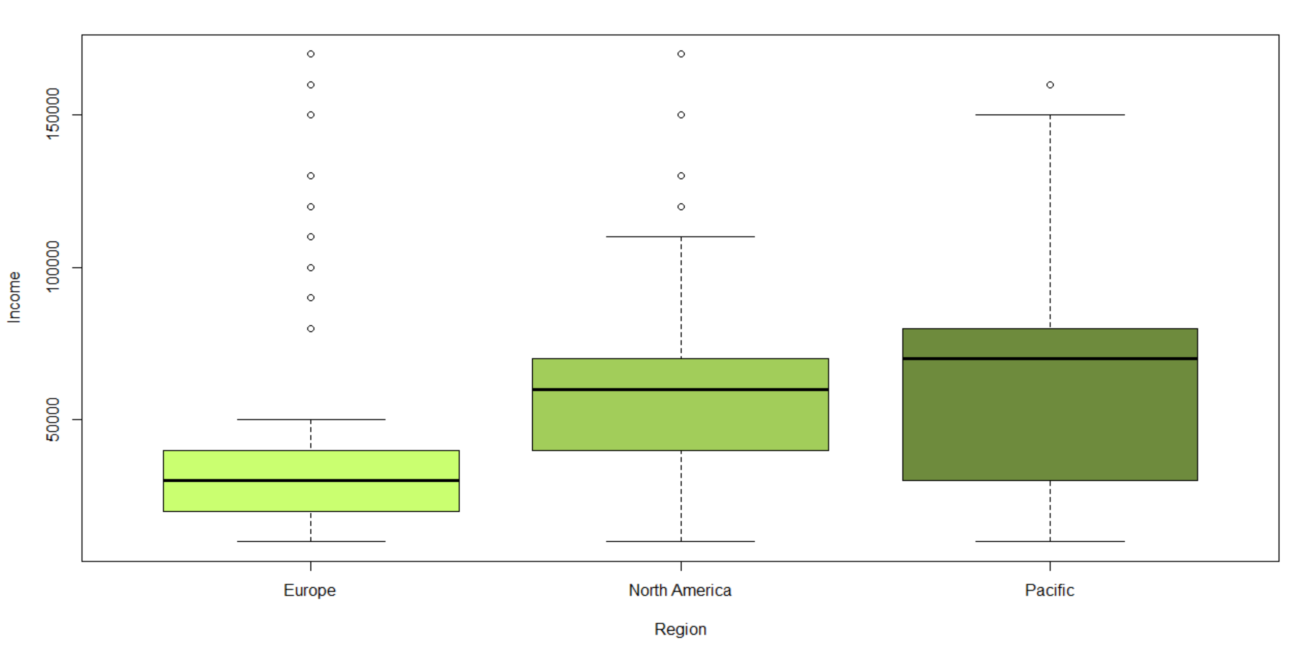
One variable at a time – anything interesting?
Commute Distance
AIC = 2480.624

Slide 6
Forward/Stepwise, AIC
Commute Distance
Education
Occupation
Income
Children
Region
Purchased Bike
Homeowner
Not included: Age and Gender
AIC = 1870.065

Slide 7
Interaction
A few improved
Some errors
Tried those that made sense
Smallest AIC = 1775.54
Commute Distance and Education
Commute Distance and Region
Too many variables, decided against

Slide 8
Nominal Vs Ordinal
Commute Distance (0,1,2,5,10) and (0,1,2,3,4)
Education (0,1,2,3,4)
Children (0,1,2,3,4,5)
Occupation

Slide 9
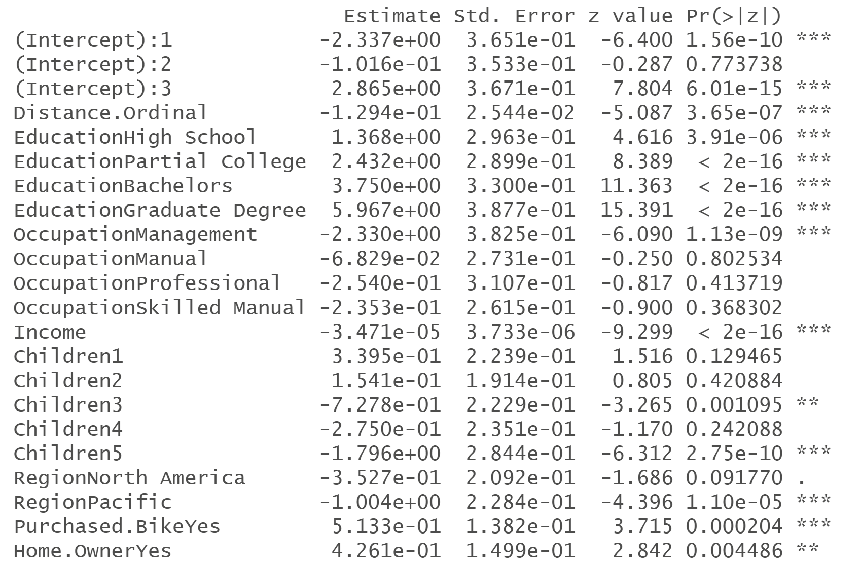
Final Model
AIC = 1865.938
For every $1000 increase in income, we estimate the odds of having at least x cars to increase multiplicatively by exp(0.03471) = 1.035319*
A graduate degree is associated with decreased odds of having at least x cars by exp(2.217) = 9.18 times what having an undergraduate degree does*
*controlling for all else

Slide 10
How does the model look?
Proportionate odds assumption? Too complex a model
Parallel = F gives an error
Standardized Residuals
69 were </> 3
1268.557262 !
Man who commutes a long distance and has 3 kids but 0 Cars
All outliers have either 0 or 1 cars, but the huge outliers have 0

Slide 11
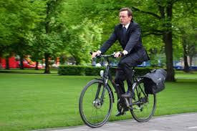
Predicting for Myself
½ mile, Undergrad degree, Professional, Not a lot of $$, 0 kids, North America
P(Y = 0) = 0.5279957
P(Y = 1) = 0.3847396
P(Y = 2) = 0.0823671
P(Y = 3) = 0.0048976

Slide 12
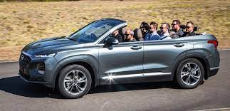
Predicting for Myself in 10 years
2-5 miles, Graduate degree, Management, $120,000, 0 kids, Moved to New Zealand, Homeowner
P(Y = 0) = 0.02408233
P(Y = 1) = 0.1633929
P(Y = 2) = 0.6301142
P(Y = 3) = 0.1824106

Slide 13
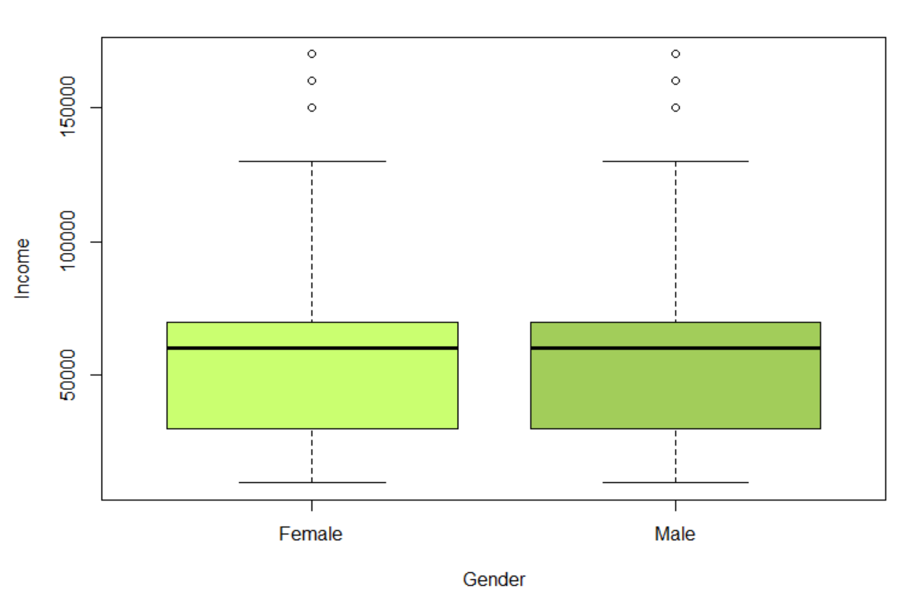
Limitations
Too clean?
Unsourced
Age/Gender left out
Residuals
Car ownership
Is it one shop?
Future Explorations
More information about the type of bike bought
City vs Countryside
How do bike customers differ from general public?

Slide 14
Thank you!

